Slide 1
3-D Holographic Near-Field MIMO-ISAR Millimeter-Wave Imaging
Josiah W. Smith
ECE PhD Candidate
The University of Texas at Dallas
jws160130@utdallas.edu
Notes:
My name is Josiah Smith. I am PhD student at The University of Texas at Dallas pushing the limits of high-resolution radar imaging and deep learning.
Today, I’m going to show you the strides we have been making in near-field MIMO-ISAR millimeter-wave imaging.
In this presentation, I’m going to guide you through the innerworkings of our fully integrated rotational inverse synthetic aperture radar system capable of reconstructing high-fidelity 3-D holographic images.

Slide 2
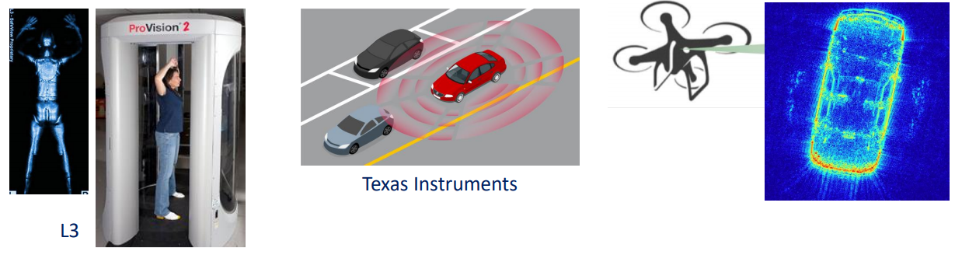

Motivation
Millimeter-wave imaging sensors have a large application space including security sensing, automotive radar, high-resolution imaging, and many more!
Goal: Construct a high resolution mmWave imaging system for holographic 3-D image reconstruction using ISAR techniques and commercially available mmWave radar sensors
Approach: Develop an efficient Fourier-based algorithm for MIMO-ISAR image reconstruction and build an x-y-$θ$ mechanical scanner to synthesize both rectangular and cylindrical apertures.
Notes:
Millimeter-wave sensors have recently emerged as a promising solution to a variety of sensing problems in the arenas of security sensing, automotive radar, high-resolution imaging, and more. Additionally, millimeter-wave radar devices are becoming increasingly affordable due to advancements in system-on-chip RF integrated circuit technology.
The goal of this work is to construct a high resolution mmWave imaging system for holographic 3-D image reconstruction using ISAR techniques and commercially available mmWave radar sensors.
To accomplish this goal, we develop an efficient Fourier-based algorithm for MIMO-ISAR image reconstruction and build a three-dimensional mechanical scanner to synthesize both rectangular and cylindrical apertures.

Slide 3
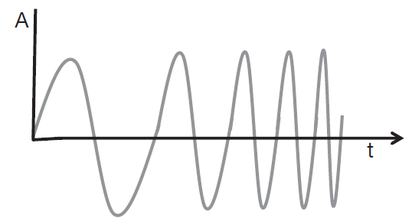
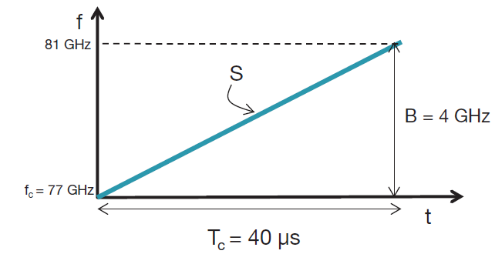
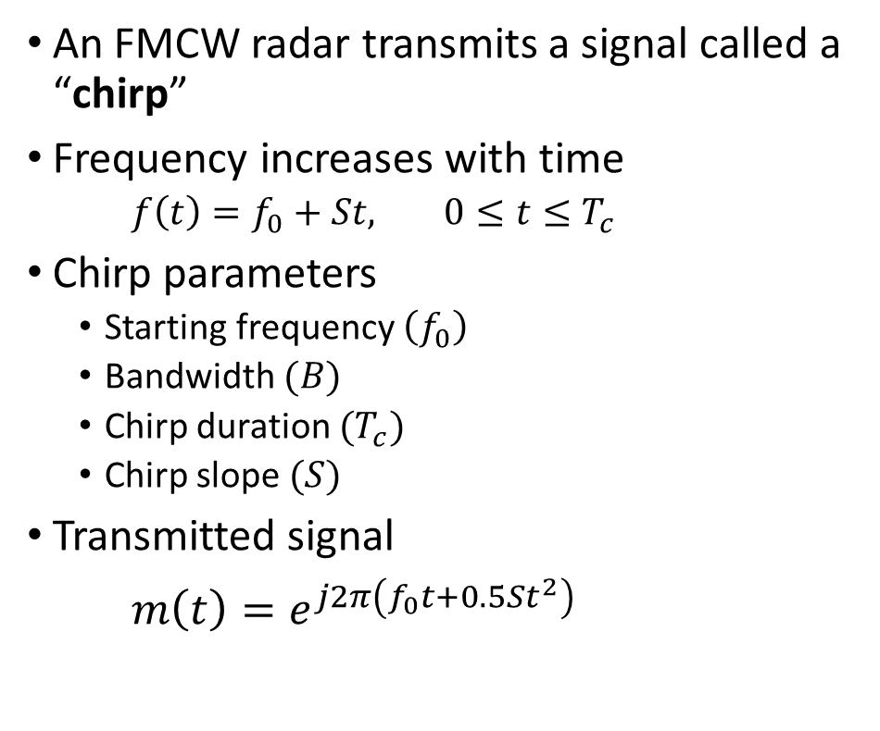
Background: FMCW Signal Model
An FMCW radar transmits a signal called a “chirp”
Frequency increases with time
$f\left(t\right)=f_{0}+St,$ $0≤t≤T_{c}$
Chirp parameters
Starting frequency $\left(f_{0}\right)$
Bandwidth $(B)$
Chirp duration $(T_{c})$
Chirp slope $(S)$
Transmitted signal
$m\left(t\right)=e^{j2π\left(f_{0}t+0.5St^{2}\right)}$
Amplitude vs. Time
Frequency vs. Time
Notes:
I will first overview some background information on the frequency-modulated-continuous-wave or FMCW modulation scheme. An FMCW radar transmits what is called a “chirp” signal. The FMCW chirp signal is a sinusoid that increases in frequency with time and can be modeled by the complex exponential expressed below.

Slide 4
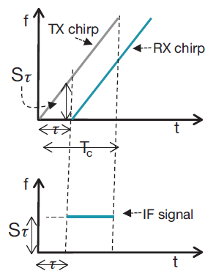
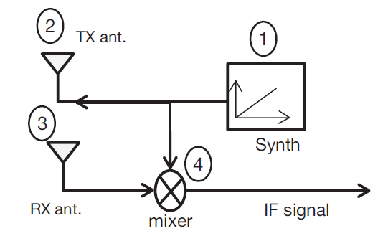
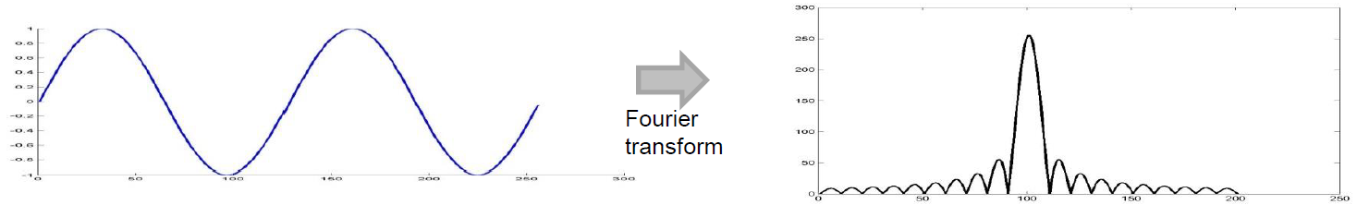

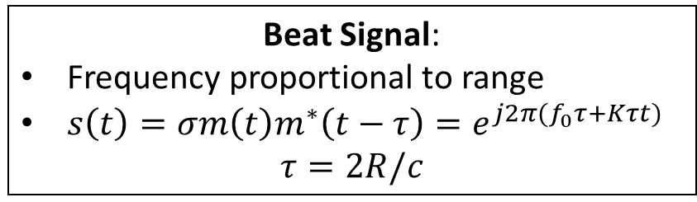
Background: FMCW Signal Model
Synthesizer generates chirp signal
Chirp is transmitted by Tx antenna
Chirp is reflected from a target to Rx antenna as $σm(t−τ)$
Tx signal and Rx signal are mixed resulting in the “beat signal”
Beat Signal:
Frequency proportional to range
$s\left(t\right)=σm\left(t\right)m^{∗}\left(t−τ\right)=e^{j2π(f_{0}τ+Kτt)}$
$$τ=2R/c$$
IF Signal vs. Time
Range
Notes:
First, an FMCW chirp is synthesized with the specified parameters. The chirp, m(t), is transmitted from the Tx antenna, reflected from a target in the scene, and received at the Rx antenna as a scaled, time delayed version of the transmitted signal, sigma m(t – tau). The transmitted and received signals are mixed, resulting in the “IF signal” or “beat signal.”
The FMCW beat signal contains high-resolution information about the target scene. The range of the target is embedded in the frequency of the beat signal and can be extracted with a Fourier transform, as shown below.

Slide 5



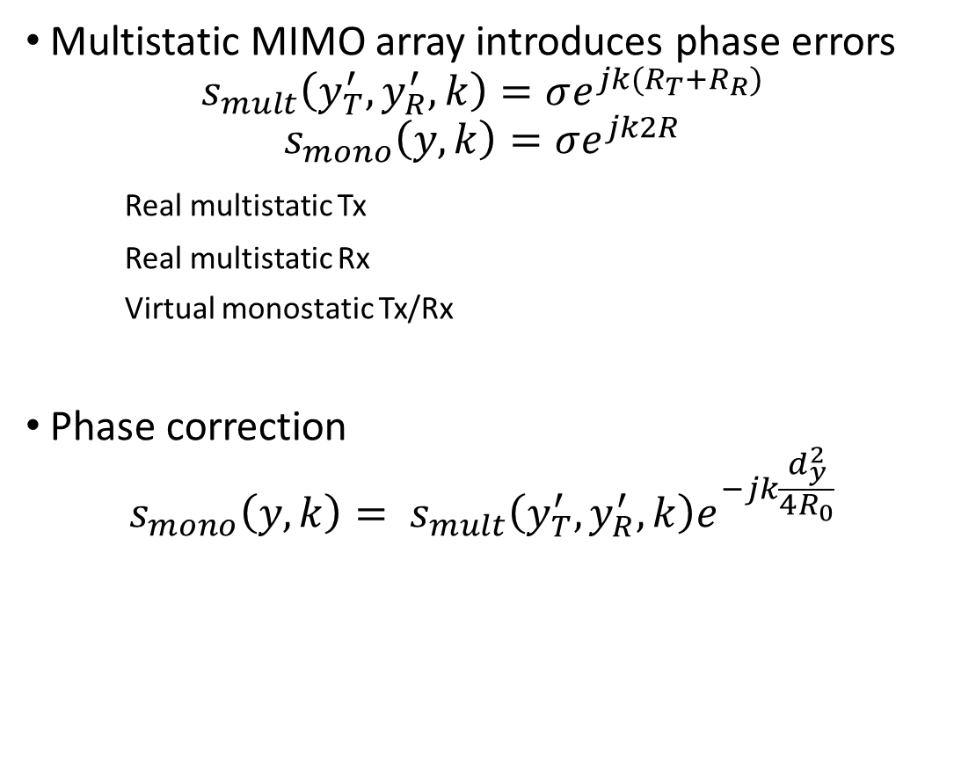

Multistatic-to-Monostatic Conversion
Multistatic MIMO array introduces phase errors
$$s_{mult}\left(y_{T}^{′},y_{R}^{′},k\right)=σe^{jk(R_{T}+R_{R})}$$
$$s_{mono}\left(y,k\right)=σe^{jk2R}$$
Real multistatic Tx
Real multistatic Rx
Virtual monostatic Tx/Rx
Phase correction
$${s_{mono}\left(y,k\right)= s}_{mult}\left(y_{T}^{′},y_{R}^{′},k\right)e^{−jk\frac{d_{y}^{2}}{4R_{0}}}$$
$$2R ≠R_{T}+R_{R}$$
$$R_{R}$$
Reflector
$$R$$
$$R_{T}$$
Notes:
Even though the multistatic MIMO array can be approximated by a virtual array of elements at the midpoint of each Tx/Rx pair, the multistatic nature of the MIMO radar introduces phase errors compared to the virtual monostatic array.
However, for small distances between Tx and Rx elements, these errors can be somewhat compensated for using a phase correction known in the literature and expressed below. This multistatic-to-monostatic conversion enables the use of spatially efficient MIMO arrays and computationally efficient monostatic image reconstruction algorithms.

Slide 6
Phase Profile
Multistatic Phase Profile
After Multistatic-to-Monostatic Conversion

Slide 7
Multistatic Point Spread Function
Multistatic artifacts

Slide 8
After Multistatic-to-Monostatic Conversion

Slide 9
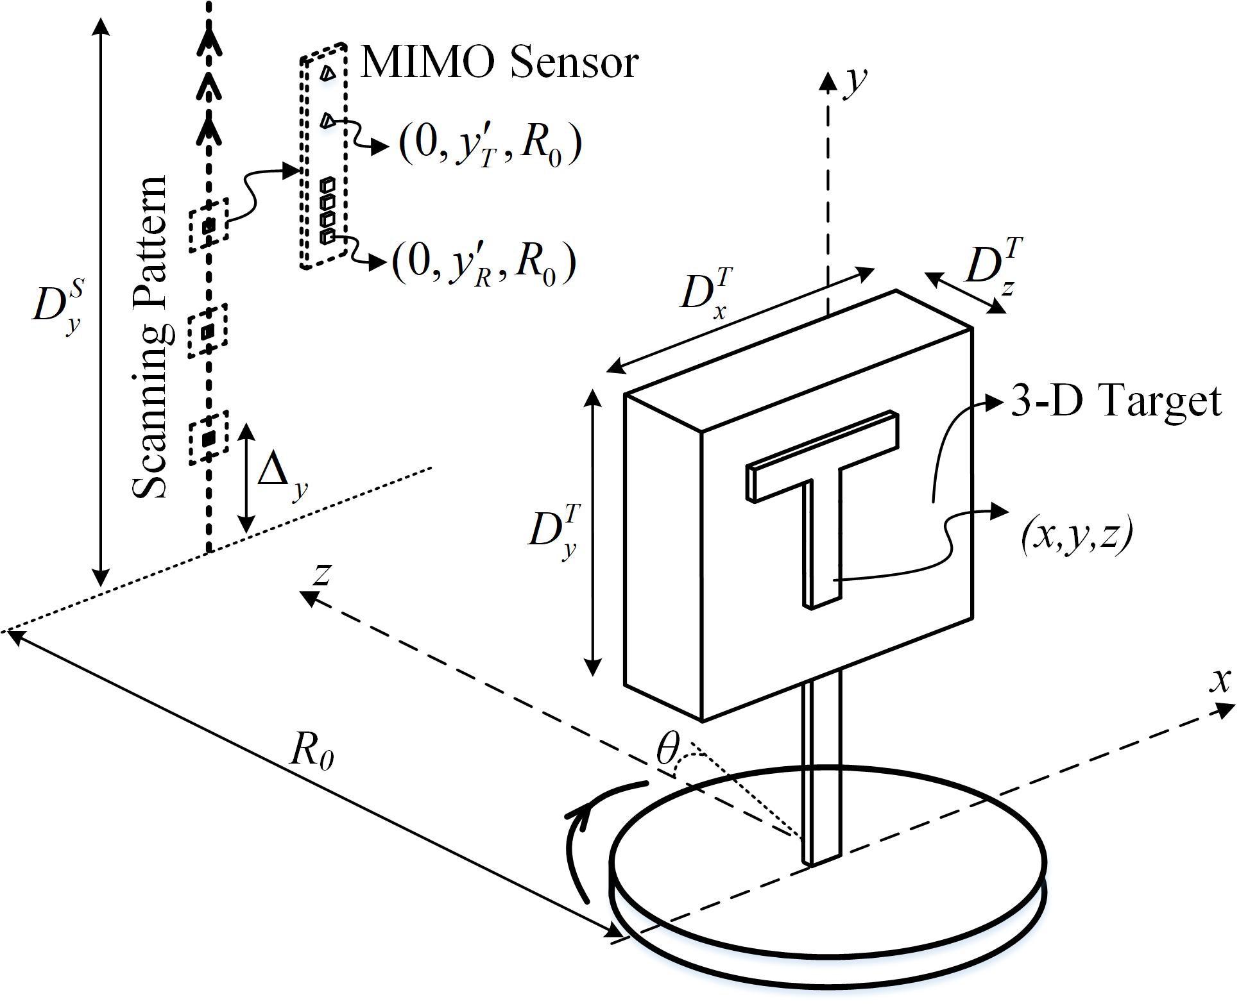
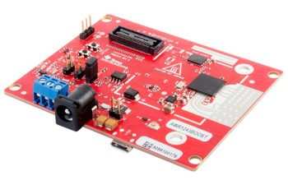
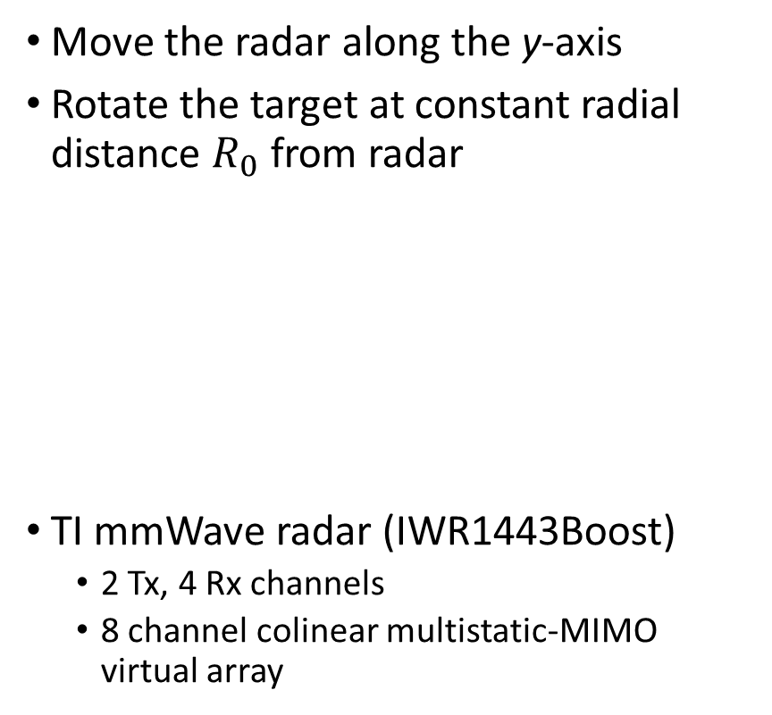
MIMO-R-ISAR System Configuration
Move the radar along the y-axis
Rotate the target at constant radial distance $R_{0}$ from radar
TI mmWave radar (IWR1443Boost)
2 Tx, 4 Rx channels
8 channel colinear multistatic-MIMO virtual array
Notes:
Our system consists of three main components: a linear vertical scanner, rotator, and FMCW radar. The linear mechanical scanner moves the radar along the y-axis up and down. The target is mounted to the rotator, which rotates the target at a constant radial distance (R naught) from the radar scanning plane. The target coordinates are in (x, y, z) and the position of each element in the synthetic aperture are at the points (R naught cosine theta, y’, R naught sine theta) in (x, y, z) space. Lastly, we will use a TI mmWave radar with 2 Tx and 4 Rx channels resulting in an 8-channel colinear multistatic-MIMO virtual array.

Slide 10
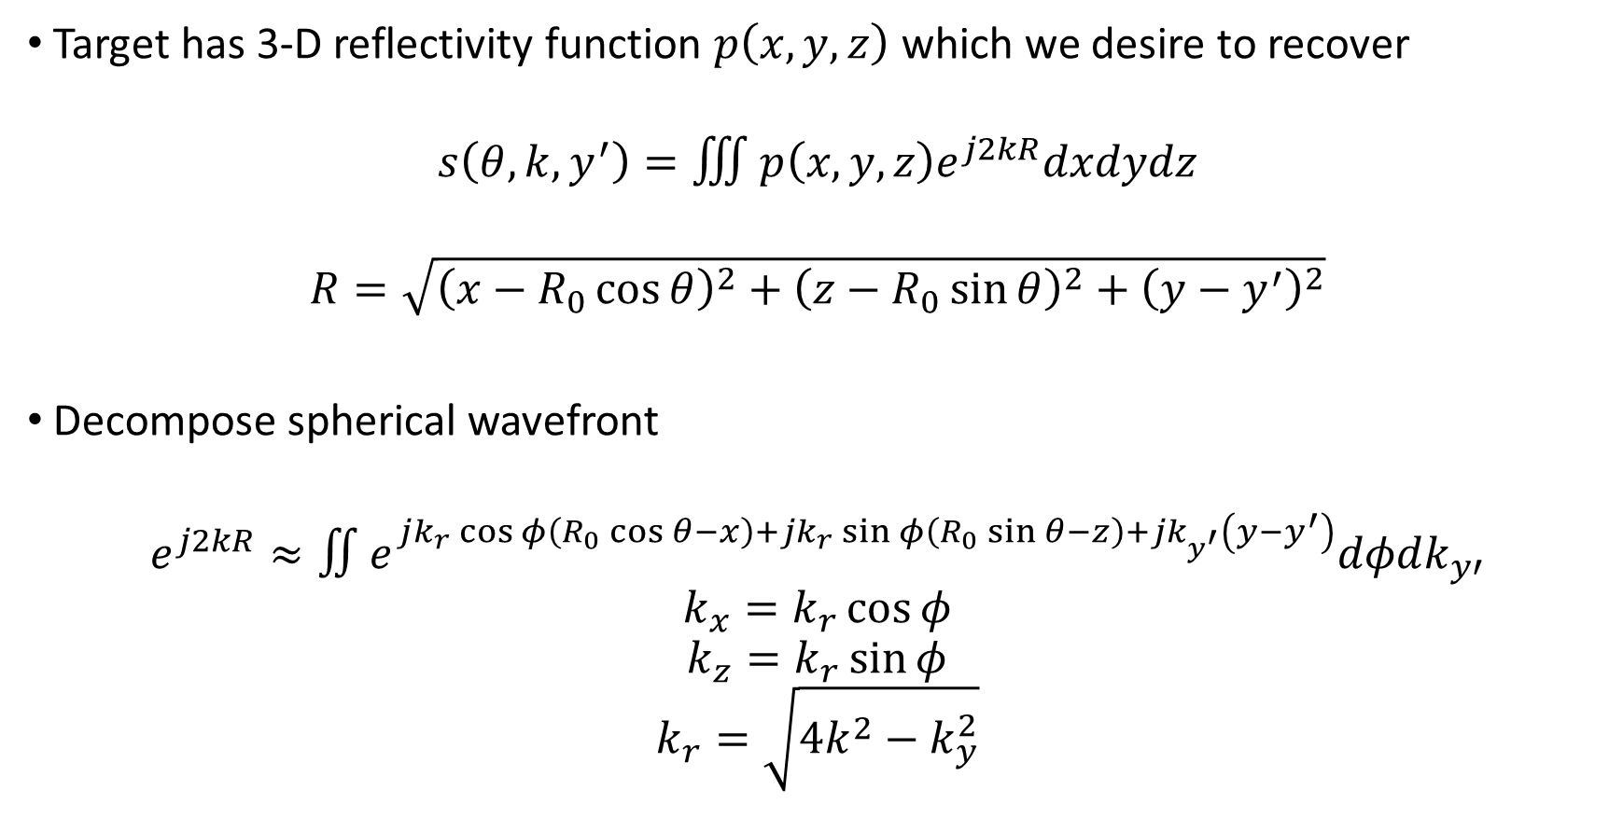
Image Reconstruction
Target has 3-D reflectivity function $p\left(x,y,z\right)$ which we desire to recover
$$s\left(θ,k,y^{′}\right)=∭p\left(x,y,z\right)e^{j2kR}dxdydz$$
$$R=\sqrt{{\left(x−R_{0}\cos{θ}\right)}^{2}+{\left(z−R_{0}\sin{θ}\right)}^{2}+{\left(y−y^{′}\right)}^{2}}$$
Decompose spherical wavefront
$$e^{j2kR}≈∬e^{jk_{r}\cos{φ}\left(R_{0}\cos{θ}−x\right)+jk_{r}\sin{φ}\left(R_{0}\sin{θ}−z\right)+jk_{y^{′}}\left(y−y^{′}\right)}dφdk_{y′}$$
$$k_{x}=k_{r}\cos{φ}$$
$$k_{z}=k_{r}\sin{φ}$$
$$k_{r}=\sqrt{4k^{2}−k_{y}^{2}}$$
Notes:
Now, I will overview the mathematical derivation of the Fourier-based rotational ISAR image reconstruction algorithm. The goal of this algorithm is to recover the target reflectivity function p(x, y, z).
First, the received beat signal can be modeled as the superposition of spherical waves from each point in the target scene weighted by the target reflectivity function, as shown in the equation at the top of the page.
Note the nonlinear phase term due to the radial distance (R) from each element of the synthetic aperture to the points of the target. While this integral can easily be inverted, the back-projection approach comes at excessive computational cost.
Instead, we develop a Fourier-based technique by first decomposing the spherical wavefront into the superposition of plane waves using the method of stationary phase.

Slide 11
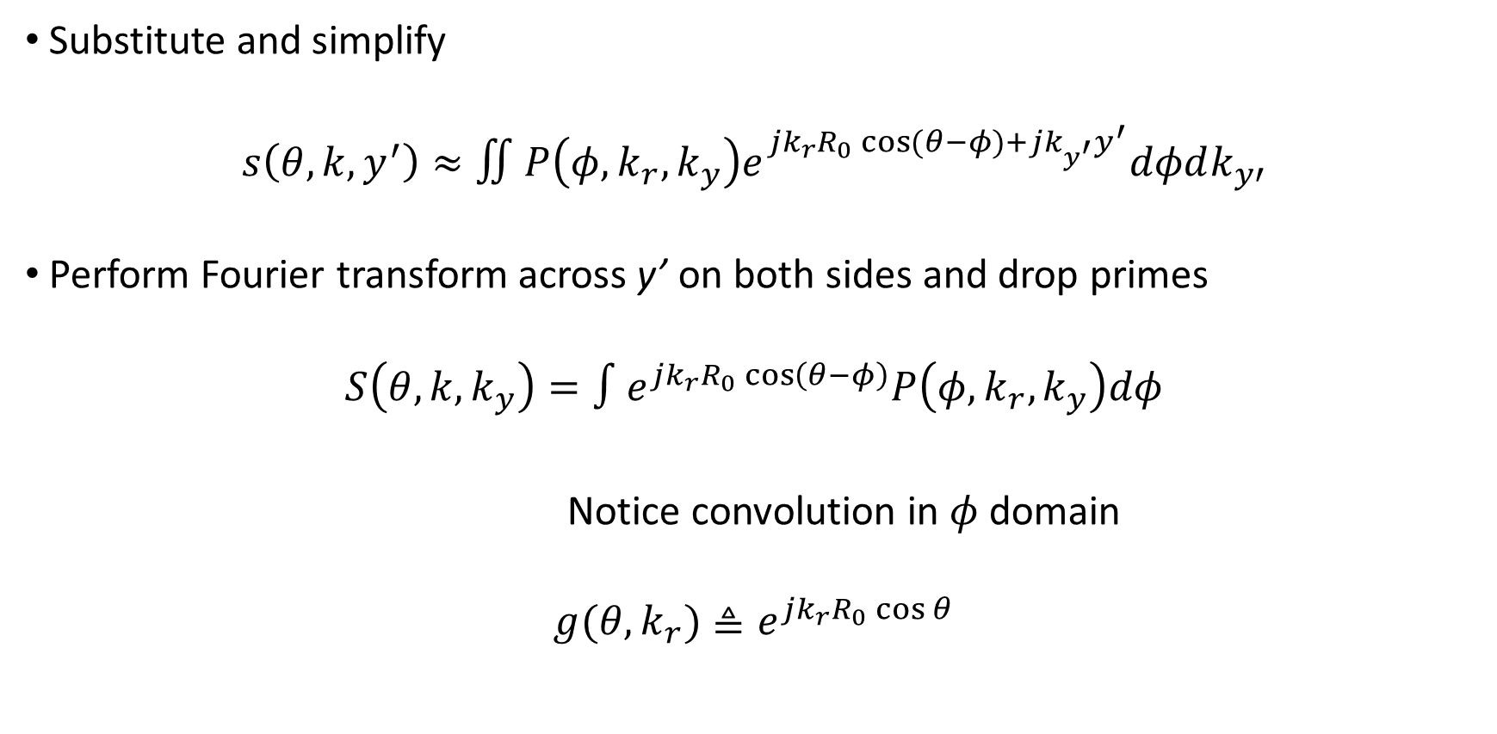
Image Reconstruction
Substitute and simplify
$$s\left(θ,k,y^{′}\right)≈∬P\left(φ,k_{r},k_{y}\right)e^{jk_{r}R_{0}\cos{(θ−φ)}+jk_{y^{′}}y^{′}}dφdk_{y′}$$
Perform Fourier transform across y’ on both sides and drop primes
$$S\left(θ,k,k_{y}\right)=∫e^{jk_{r}R_{0}\cos\left(θ−φ\right)}P\left(φ,k_{r},k_{y}\right)dφ$$
Notice convolution in $φ$ domain
$$g(θ,k_{r})≜e^{jk_{r}R_{0}\cos{θ}}$$
Fourier relation in cylindrical coordinates: $P\left(φ,k_{r},k_{y}\right)⇔p\left(x,y,z\right)$
Notes:
Substituting the previous expression into the first equation and simplifying some Fourier relations yields the following equation where P(phi, k r, k y) is the 3D Fourier transform of p(x, y, z) in cylindrical coordinates.
Next, a Fourier transform across y’ is performed on both sides.
Now, it is obvious that the integral on the right is simply a convolution in the phi domain, where we define g(theta, k r) as shown.

Slide 12
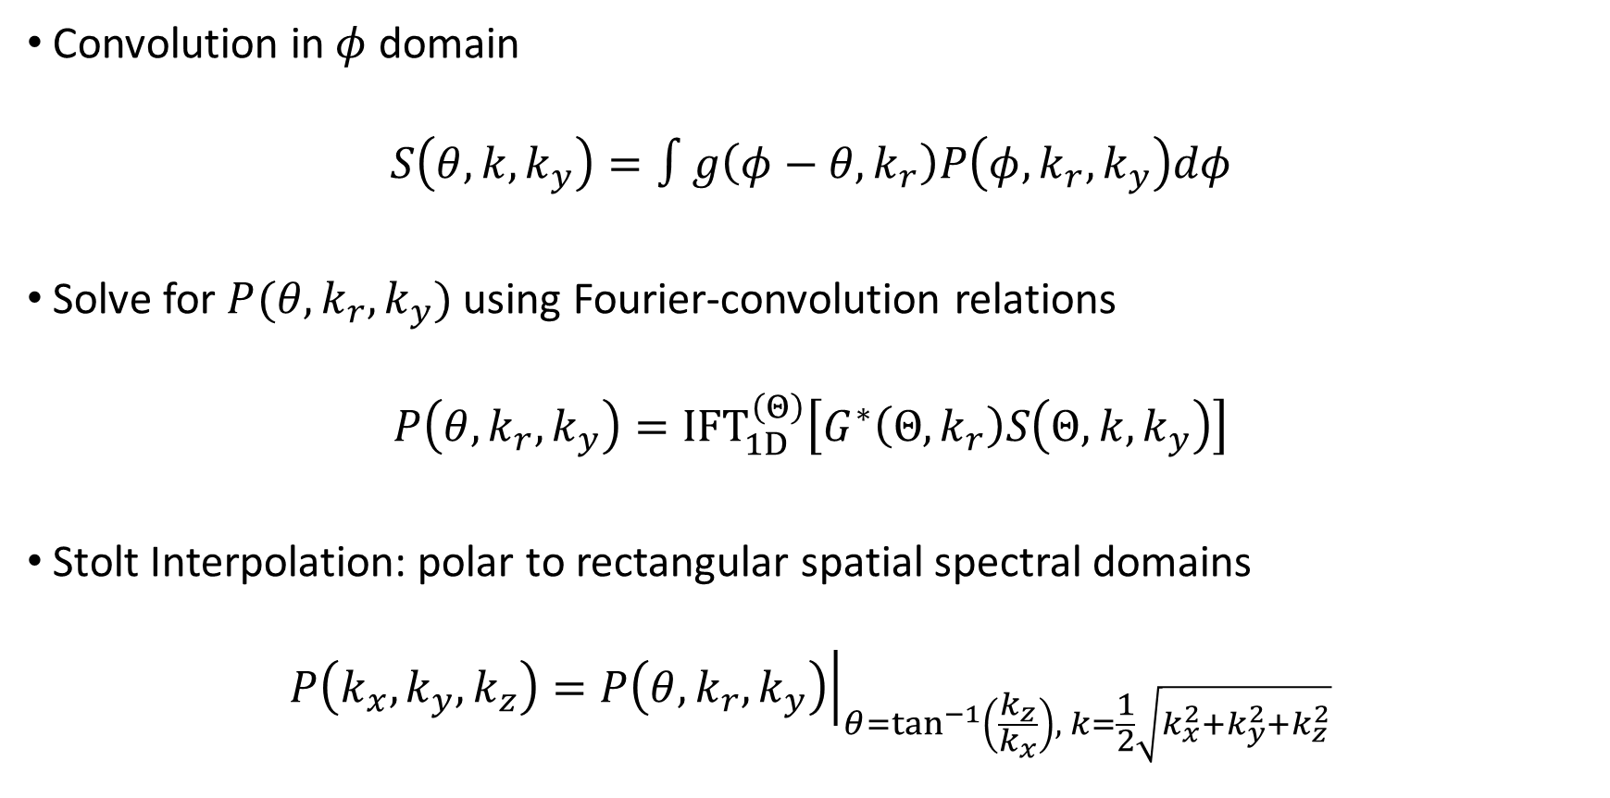
Image Reconstruction
Convolution in $φ$ domain
$$S\left(θ,k,k_{y}\right)=∫g\left(φ−θ,k_{r}\right)P\left(φ,k_{r},k_{y}\right)dφ$$
Solve for $P(θ,k_{r},k_{y})$ using Fourier-convolution relations
$$P\left(θ,k_{r},k_{y}\right)={IFT}_{1D}^{\left(Θ\right)}\left[G^{∗}\left(Θ,k_{r}\right)S\left(Θ,k,k_{y}\right)\right]$$
Stolt Interpolation: polar to rectangular spatial spectral domains
$$P\left(k_{x},k_{y},k_{z}\right)={\left.P\left(θ,k_{r},k_{y}\right)\right|}_{θ=\tan^{−1}\left(\frac{k_{z}}{k_{x}}\right), k=\frac{1}{2}\sqrt{k_{x}^{2}+k_{y}^{2}+k_{z}^{2}}}$$
Notes:
The convolution integral can be written as the following.
Now, P(theta, k r, k y) can be solved using Fourier-convolution relations easily as shown.
Since P(theta, k r, k y) is sampled on a uniform cylindrical grid, it must be interpolated to the k x, k y, k z domain using Stolt interpolation before taking an inverse Fourier transform.

Slide 13
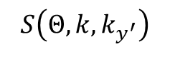
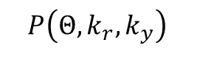
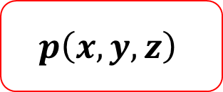
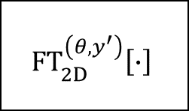
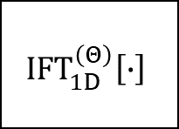
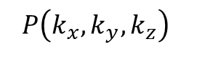
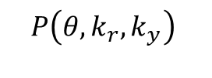

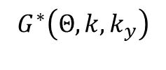

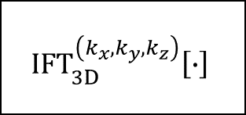
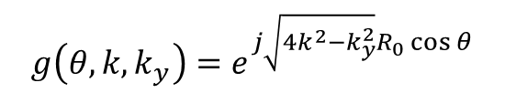
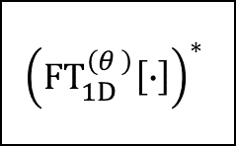
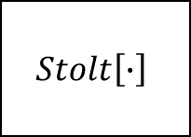
Full Algorithm
$$s\left(θ,k,y_{T}^{′},y_{R}^{′}\right)$$
$g\left(θ,k,k_{y}\right)=e^{j\sqrt{4k^{2}−k_{y}^{2}}R_{0}\cos{θ}}$
Multistatic-to-Monostatic Conversion
$${\left({FT}_{1D}^{\left(θ \right)}\left[∙\right]\right)}^{∗}$$
$$Stolt\left[∙\right]$$
$$P\left(k_{x},k_{y},k_{z}\right)$$
$${IFT}_{3D}^{\left(k_{x},k_{y},k_{z}\right)}\left[∙\right]$$
$$s\left(θ,k,y′ \right)$$
$$G^{∗}\left(Θ, k,k_{y}\right)$$
$$P\left(θ,k_{r},k_{y}\right)$$
$${FT}_{2D}^{\left(θ,y^{′}\right)}\left[∙\right]$$
$${IFT}_{1D}^{\left(Θ\right)}\left[∙\right]$$
$$p\left(x,y,z\right)$$
$$S\left(Θ,k,k_{y^{′}}\right)$$
$$P\left(Θ,k_{r},k_{y}\right)$$
Notes:
The full algorithm can be summarized as follows.
First, the multistatic signal is gathered from the radar
The multistatic-to-monostatic conversion is applied yielding a virtual-monostatic approximate
A 2D Fourier transform is performed across the theta and y’ domains
The resulting signal is multiplied with the conjugate of the Fourier transform of the azimuth focusing function g()
After an inverse Fourier transform to complete the deconvolution in the angular spectral domain, the spatial spectral reflectivity function is obtained
Then P(theta, k r, k y) is interpolated to P(k x, k y, k z) using Stolt interpolation.
Finally, a 3D inverse Fourier transform yields the recovered reflectivity function p(x, y, z)
All the Fourier processing can be efficiently computed using the Fast Fourier Transform (or FFT), drastically improving the computational efficiency of this method over the back-projection algorithm. Additionally, the novel pairing of multistatic-to-monostatic conversion with rotational SAR allows us to drastically increase scanning efficiency by using a MIMO array without requiring more computationally taxing multistatic image reconstruction algorithms.

Slide 14
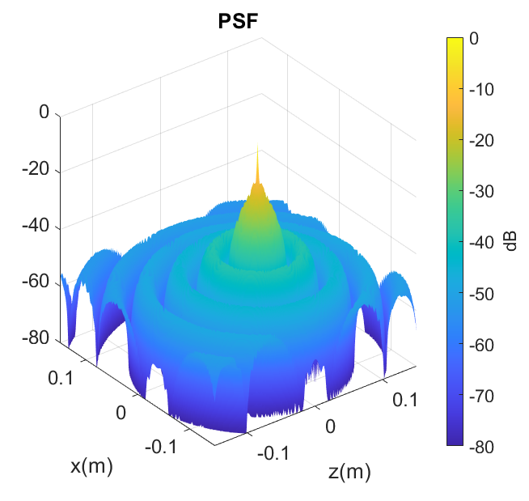
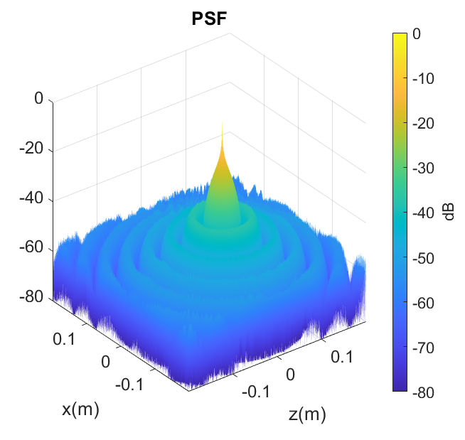
Simulations – 2-D PSF vs. BPA
Back Projection Algorithm (114s)
Proposed (500ms)

Slide 15
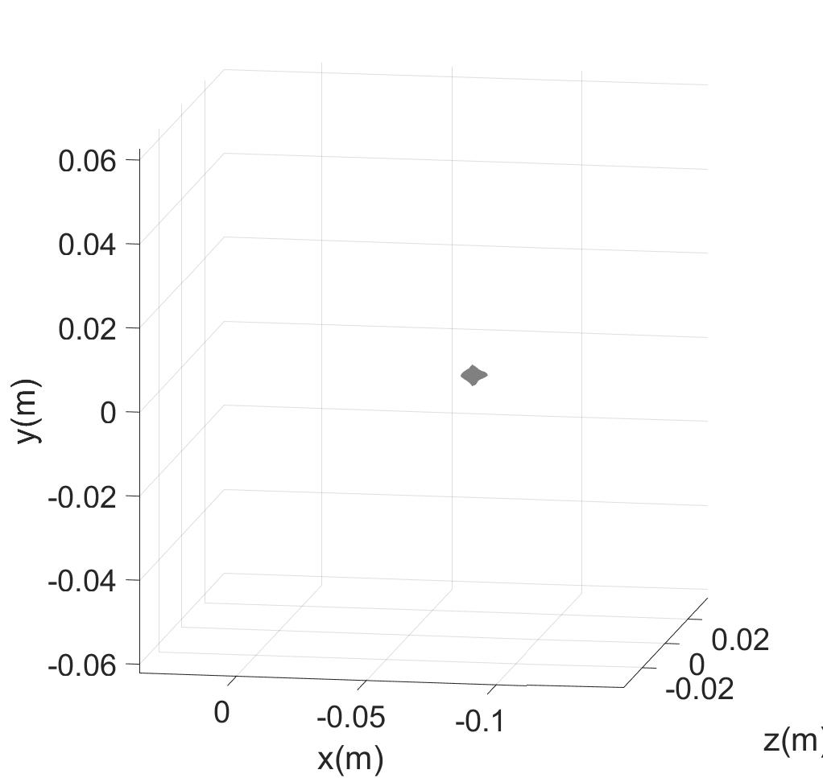
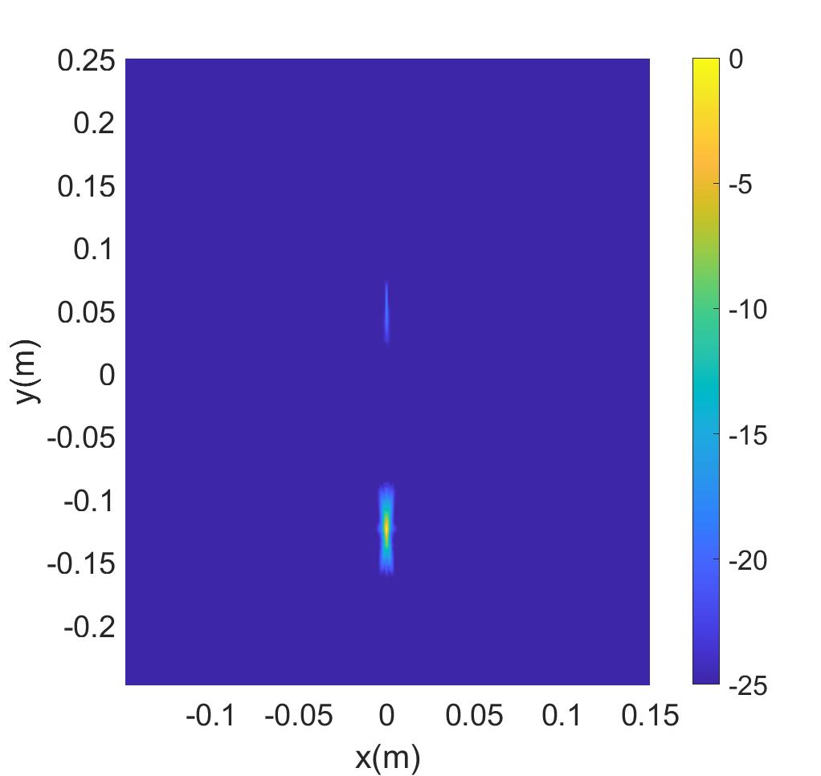
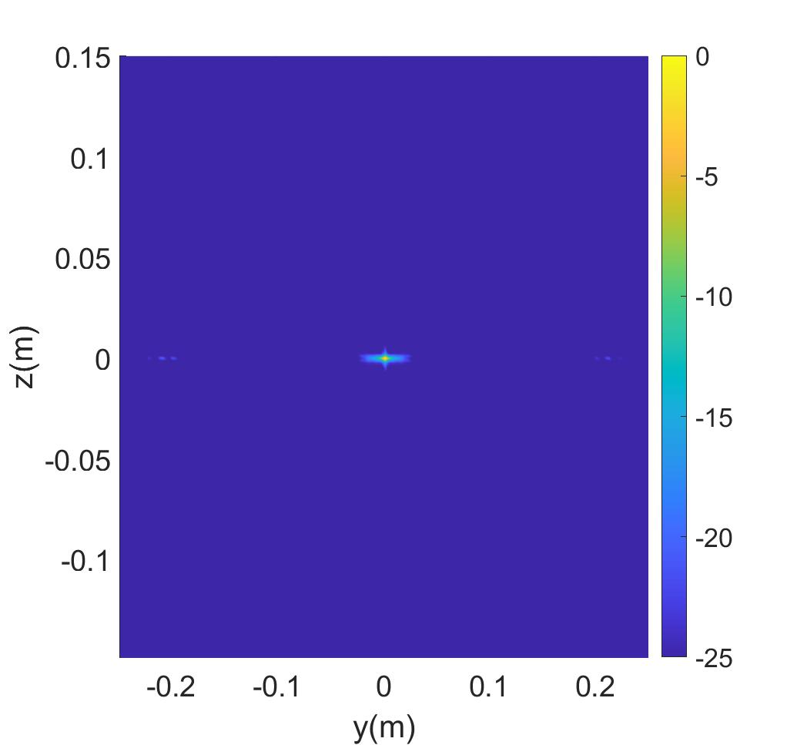
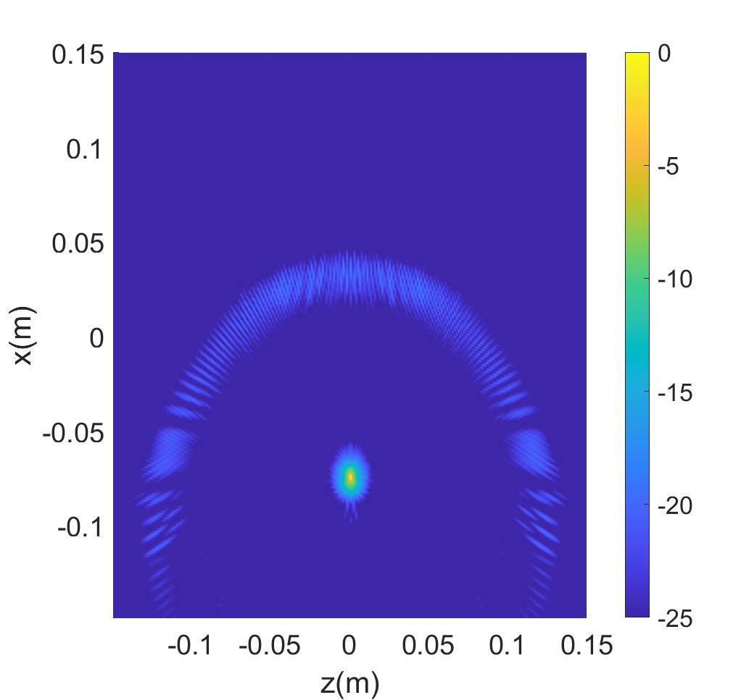
Simulation Results – 3-D PSF
(x-y) PSF
(y-z) PSF
Reconstructed PSF
(x-z) PSF

Slide 16
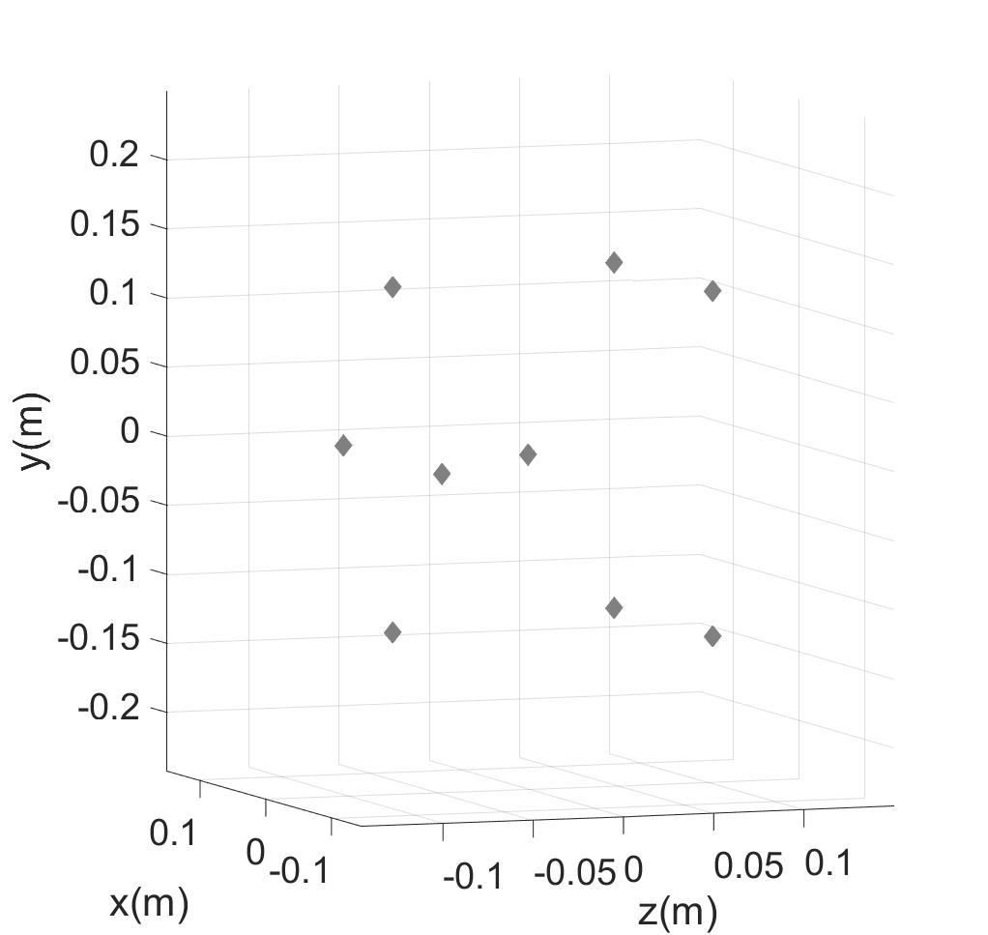

Simulation Results – 3-D Points
Input Reflectivity Function
Reconstructed Image

Slide 17
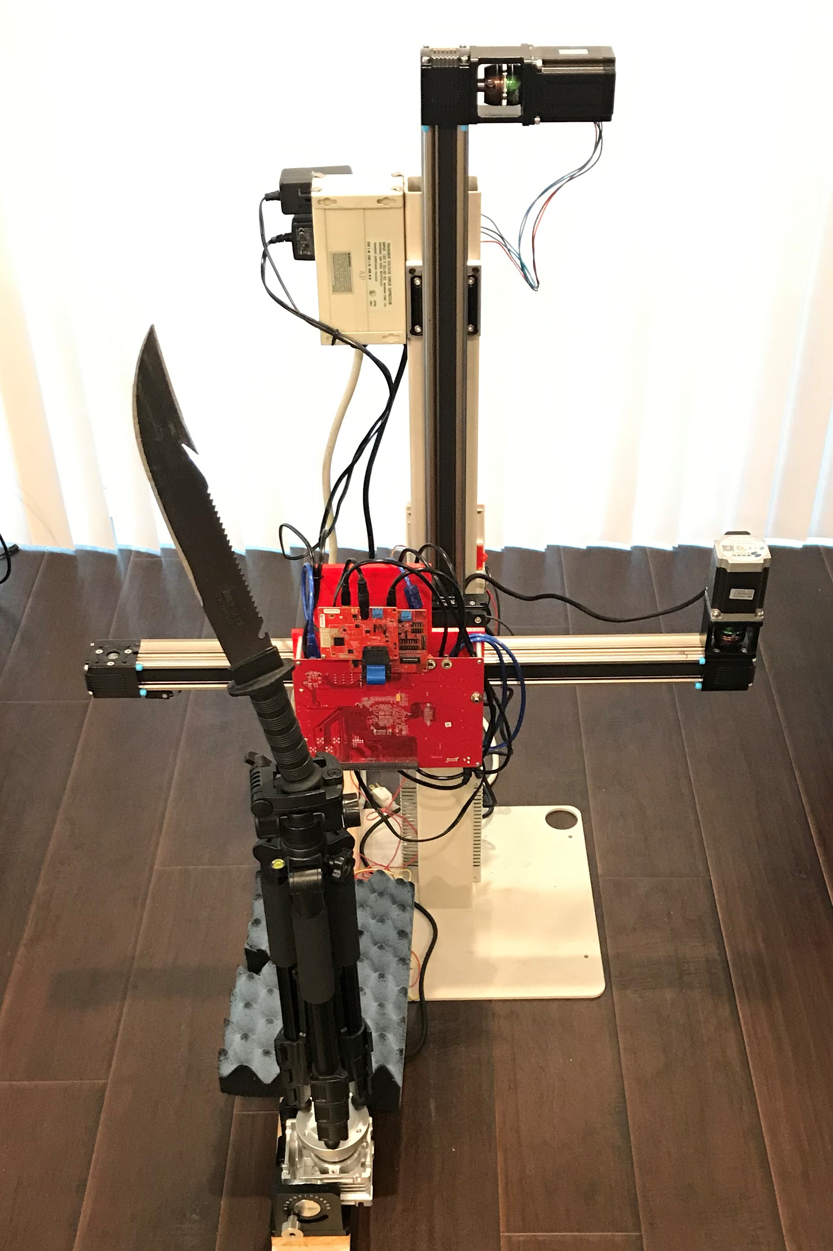
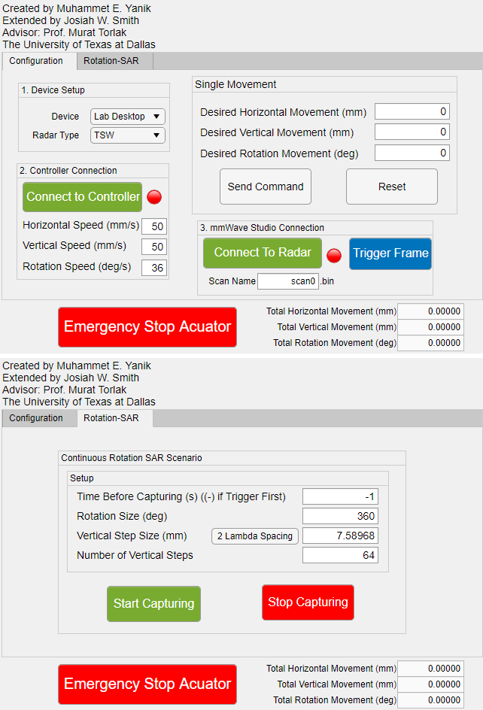

System Setup
x-y-$θ$ mechanical scanner capable of synthesizing rectangular and cylindrical apertures.
Compare rectangular SAR and rotational ISAR
Microcontroller and radar controlled by MATLAB
Vertical Scanner
Notch
TI Radar
Setup Radar
Control Scan
Horizontal Scanner
Rotator
Serrated edge
Notes:
Finally, we assemble a fully integrated system with vertical, horizontal, and rotation scanning capabilities allowing for comparison between rectangular SAR and rotational ISAR. The entire scanner is controlled through a custom-built MATLAB graphical user interface that sets up the radar device and controls the scan.
We will proceed to reconstruct high resolution holographic images of the knife shown to the right. Note the notch and serrated edge of the blade, which will be visible in the subsequent images.

Slide 18
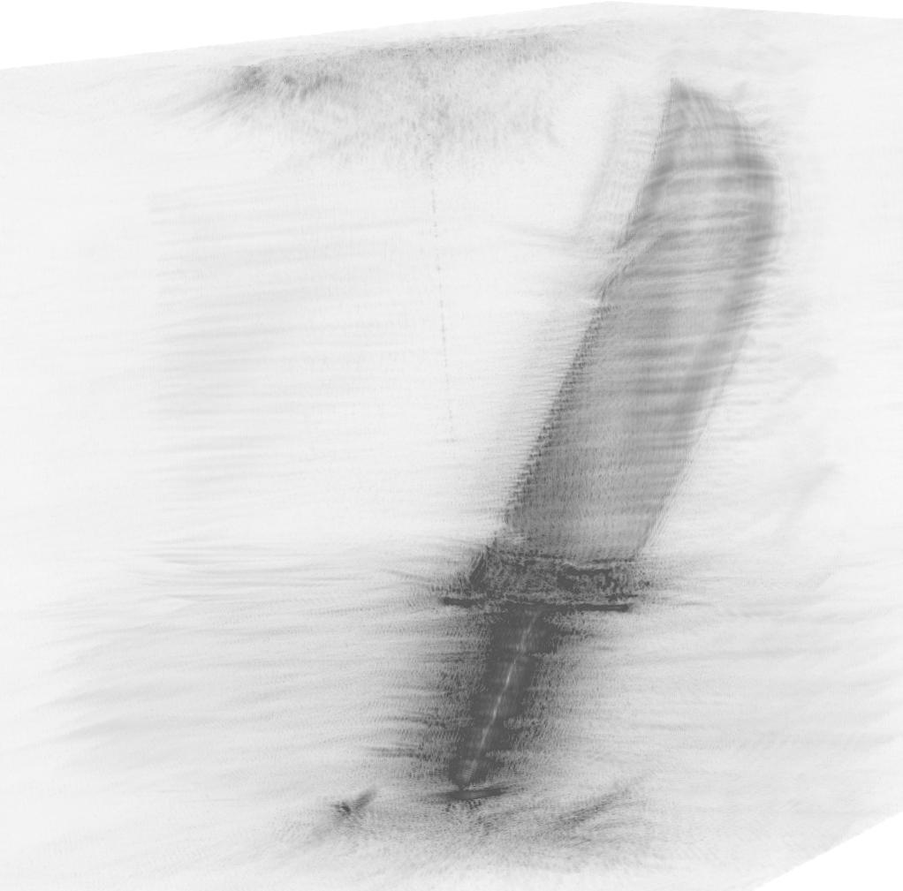
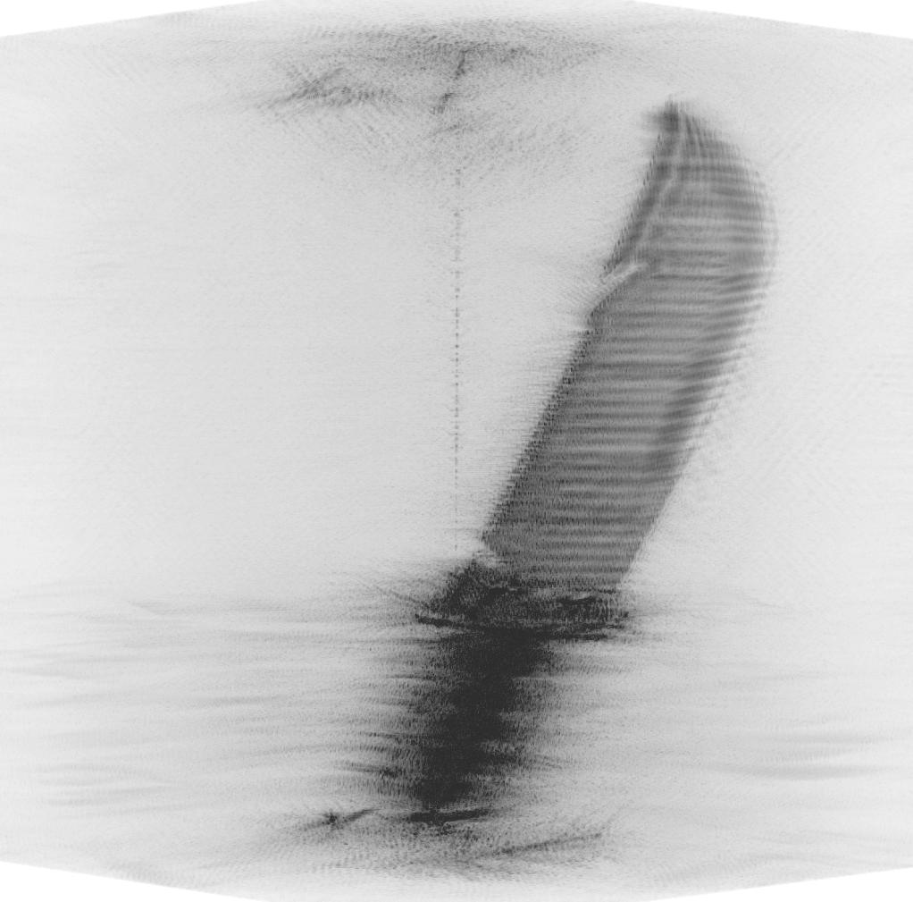
Rotational ISAR – Imaging Results
Cylindrical SISO Array
512 quasi-monostatic vertical elements
137 min per scan
Cylindrical MIMO Array
512 multistatic virtual vertical elements
17 min per scan
Notes:
We first compare images from a SISO array of 512 quasi-monostatic vertical elements spaced by a quarter wavelength. To scan at each of the 512 vertical locations, the entire scan took 137 minutes to complete. In contrast, the scan using a MIMO array of the same size took 17 minutes in total. Both the images show a high-quality reconstruction of the knife blade with the notch and serrated edge visible.

Slide 19
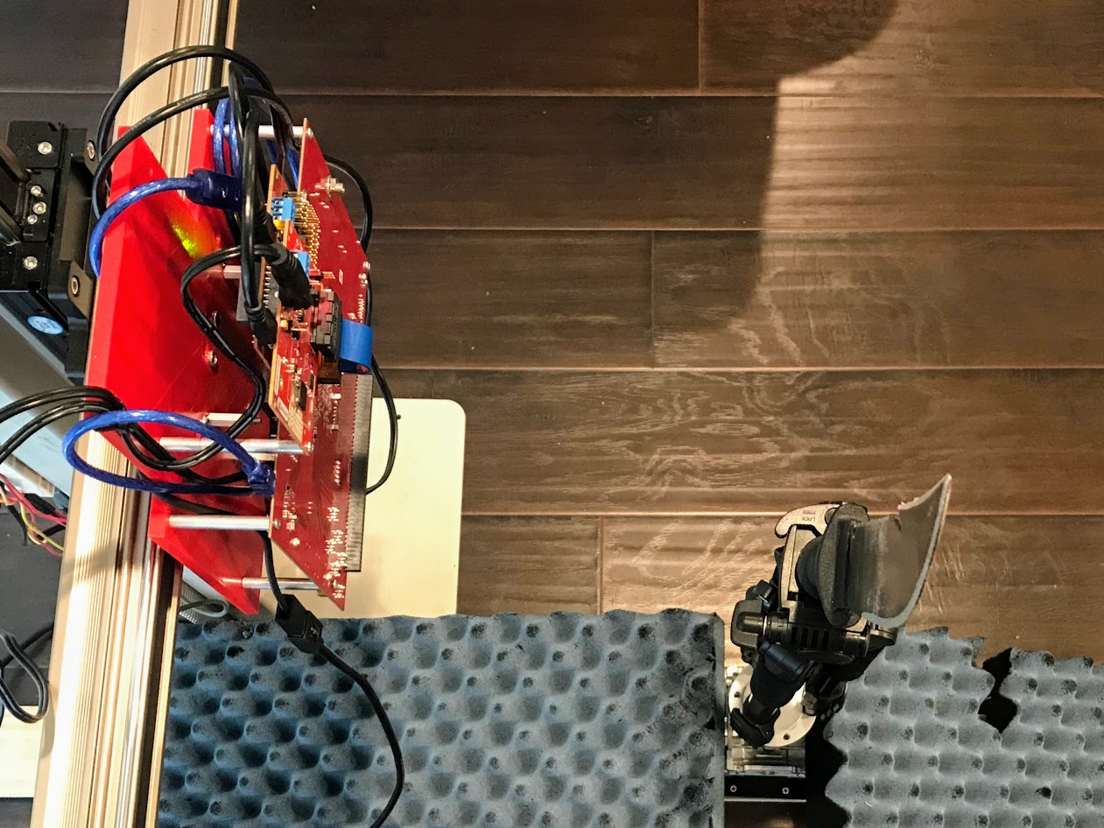
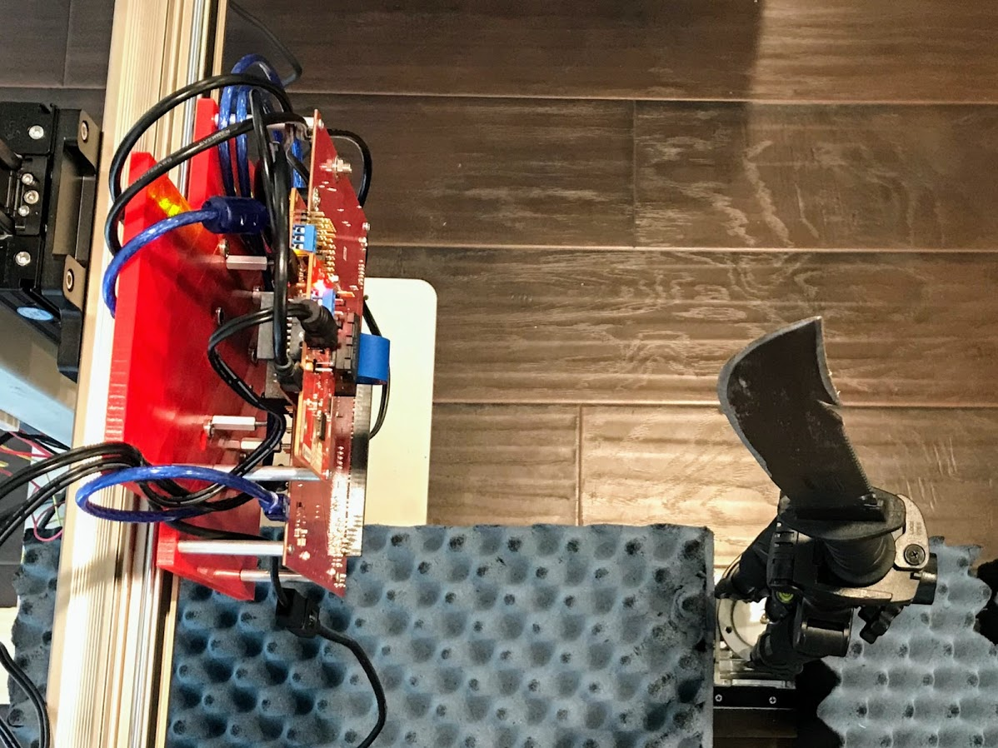
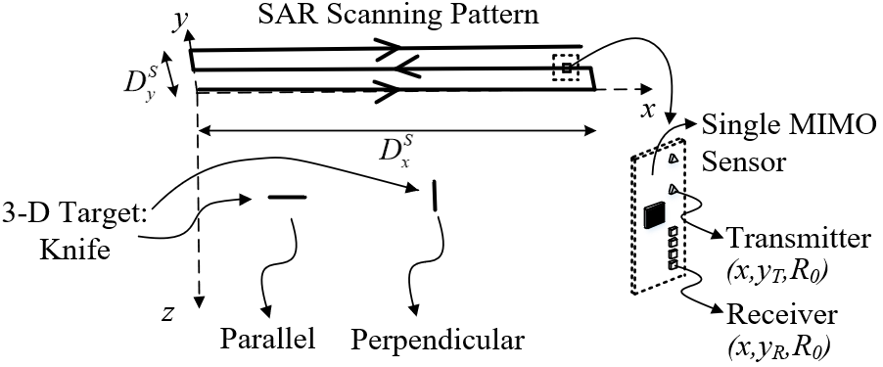
Rectangular SAR – Imaging Results
2-D scan over x-y plane
29 min per scan
Reconstruct 3-D image
Performs well when target is parallel to aperture plane
Suffers in nonideal conditions
Parallel
Perpendicular
Notes:
Next, we use the 2-D horizontal and vertical scanning axes to produce 3-D holographic images from a rectangular SAR aperture. We consider multiple cases, 1) the knife blade is parallel with the x-y aperture plane, and 2) the knife blade is perpendicular to the x-y plane. The orientation of the knife with respect to the scanner has substantial implications on the image quality.
The images on the right compare the reconstructed images of the knife blade when the knife is parallel and perpendicular to the scanning plane.

Slide 20
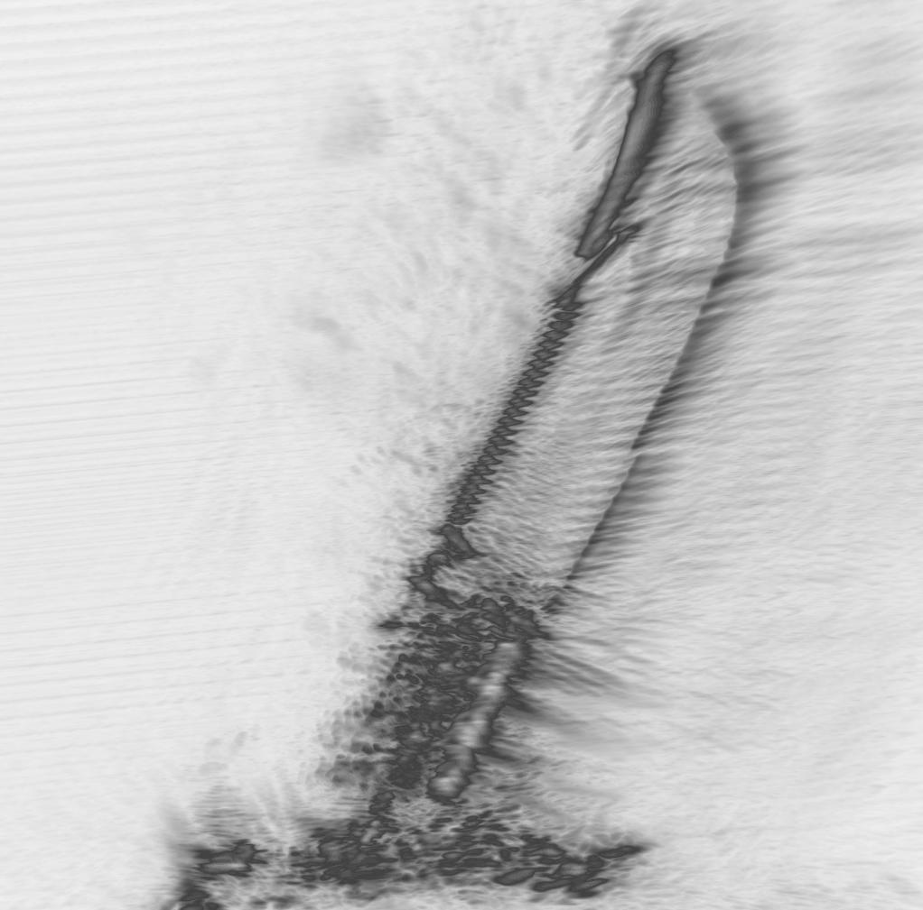
Rectangular SAR – Parallel

Slide 21
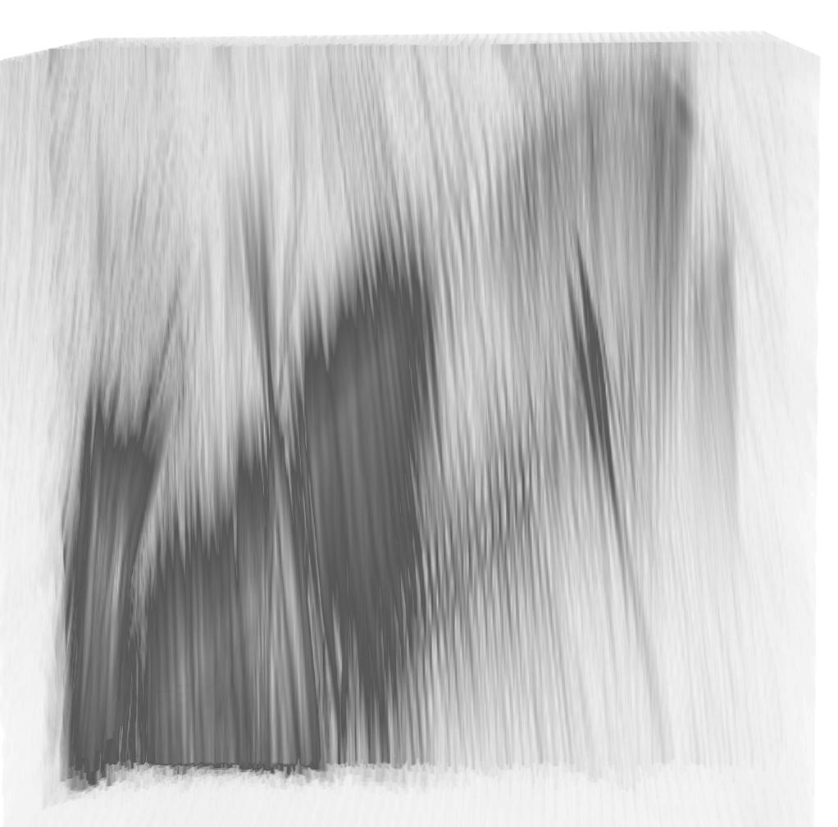
Rectangular SAR – Perpendicular

Slide 22
Rotational ISAR vs. Rectangular SAR
Rectangular MIMO-SAR
Requires specific target rotation with respect to aperture plane
Rotational MIMO-ISAR
Rotation-invariant
Improved spatial resolution
Notes:
This demonstrates the high dependence of the image quality on the knife orientation in the rectangular MIMO-SAR regime. While rectangular SAR can reconstruct high-resolution 3-D images of reflective targets, the rotation of the target drastically changes the quality of the resulting image.
By comparison, rotational MIMO-ISAR is rotation-invariant since the target is scanned across a full 360-degree aperture. Further, this results in improved spatial resolution over the rectangular SAR imaging regime.

Slide 23
Conclusion
High resolution 3-D near-field imaging system based on:
Low-cost system-on-chip mmWave FMCW radars
Multistatic-to-monostatic conversion
Fourier-based rotational ISAR imaging algorithm
Experimental results:
Validate MIMO-ISAR 3-D holographic image reconstruction algorithm
Demonstrate improved scanning efficiency over SISO systems
Establish rotation-invariance advantage of rotational ISAR over rectangular SAR
Notes:
In conclusion, we developed a high resolution 3-D near-field imaging systems based on low-cost system-on-chip mmWave FMCW radars, a multistatic-to-monostatic conversion, and an efficient Fourier-based rotational ISAR imaging algorithm.
Our experimental results validate our novel MIMO-ISAR 3-D holographic image reconstruction algorithm, demonstrate improved scanning efficiency over SISO systems, while maintaining high-resolution image quality, and establish the rotational-invariance advantage of rotational ISAR over rectangular SAR.
Proven in virtual and empirical prototyping, our fully integrated system allows for efficient near-field MIMO-ISAR mmWave imaging offering an elegant solution to many near-field imaging and sensing problems.

Slide 24

Questions?
Notes:
Thank you for attending this presentation
My name is Josiah Smith and I look forward to answering your questions shortly

